Slide 1
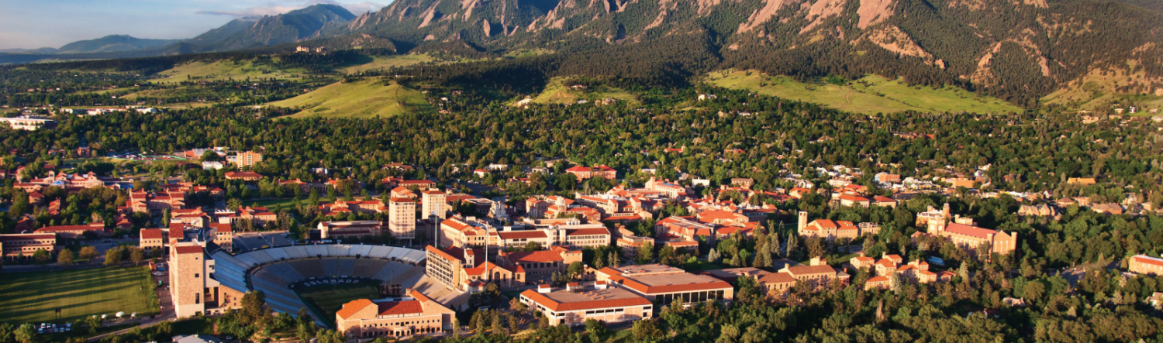

Fast Fluid Dynamics
Wangda Zuo, Ph.D.
Associate Professor, Lewis-Worcester Faculty Fellow
Department of Civil, Environmental and Architectural Engineering
University of Colorado Boulder
Wangda.Zuo@Colorado.edu

Slide 2
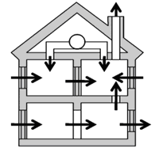
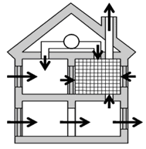
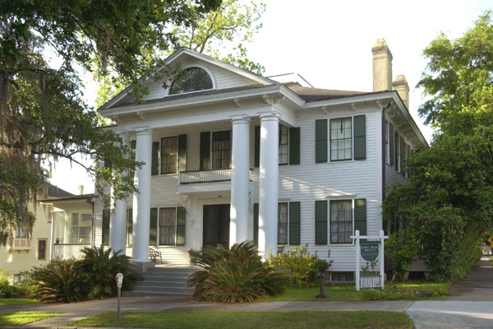
Indoor Environment Modeling Methods
Multizone Model
☹ Little Information
Accuracy (Very Poor)
☺ Very Fast
New Model
☺ Rich Information
Accuracy (Good)
Fast
Computational Fluid
Dynamics (CFD)
Rich Information
Accuracy (Excellent)
☹ Very Slow

Slide 3
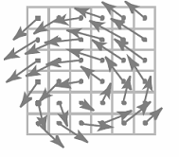
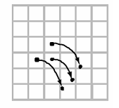
Fast Fluid Dynamics (FFD)
Momentum
Advection
Diffusion
& Source
Semi-Lagrangian
Projection
3

Slide 4
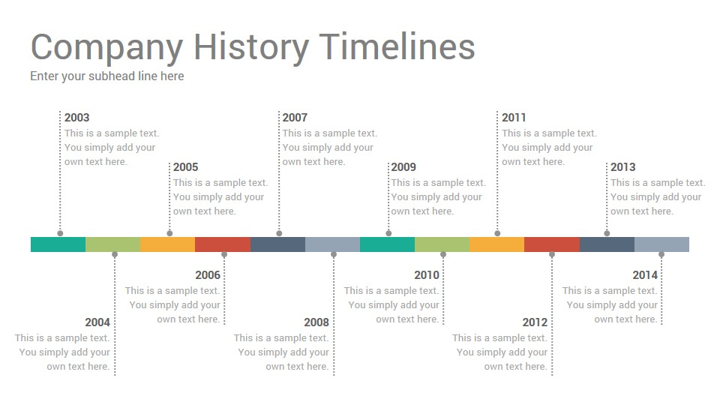
FFD for Indoor Environment Modeling
2016
Zuo et al. (2016)
Implemented a FFD module in MBL for dynamically coupled simulation
Liu et al. (2016)
Implemented FFD in OpenFOAM for simulating indoor airflow
Xue et al. (2016)
Developed a new SL-based PISO for indoor environment modeling
1999
2010
Stam (1999)
First proposed the FFD method to produce plausible real-time fluid-like flows for computer graphics applications
Zuo and Chen (2010)
Applied FFD to simulate smoke transport in buildings
Zuo and Chen (2010)
Paralleled FFD on GPU to simulate indoor airflow
2018
2012
Tian et al. (2018)
Intergraded FFD with an self-learning reduced order model ISAT
Liu and Chen (2018)
Developed a adaptive coarse grid generation method for FFD
2007
Jin and Zuo et al. (2012)
Improved FFD with local mass conservation method and a near-wall treatment for SL scheme
Zuo and Chen (2007)
First applied FFD for simulating indoor airflow for building simulation applications
2009
2015
2019
Zuo and Chen (2009)
Systematically compared performance of FFD and CFD for indoor airflow simulation
Healey and VanGilder et al. (2015)
First applied FFD to data center applications
Tian et al. (2019)
Further investigated simulating data center airflow using FFD
2001-2005
Fedkiw et al. (2001)
Applied FFD to simulate smoke motions
Harris (2003)
Applied FFD to calculate cloud movements;
Liu et al (2004)
Applied FFD to compute the flow around complex obstacles
Harris (2005)
Implemented FFD on GPU
2011
2017
Chronis et al. (2011)
Integrated FFD and GA for wind loading optimization
Tian et al. (2017)
Couple FFD and multizone airflow models
Liu et al (2017)
Developed a FFD-based adjoint method for inverse design of indoor environment

Slide 5
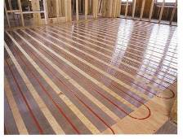
Example: Mixed Convection
Flow in a Room with
Ventilation and Floor Heating
Mixed Convection
Numerical Setting: 32 x 32 Grid, dt = 0.1s
Experimental Data: Blay et al (1992)
Blay, D., Mergui, S., and Niculae, C. 1992. "Confined turbulent mixed convection in the presence of horizontal buoyant wall jet", Fundamentals of Mixed Convection, 213, 65-72
5

Slide 6
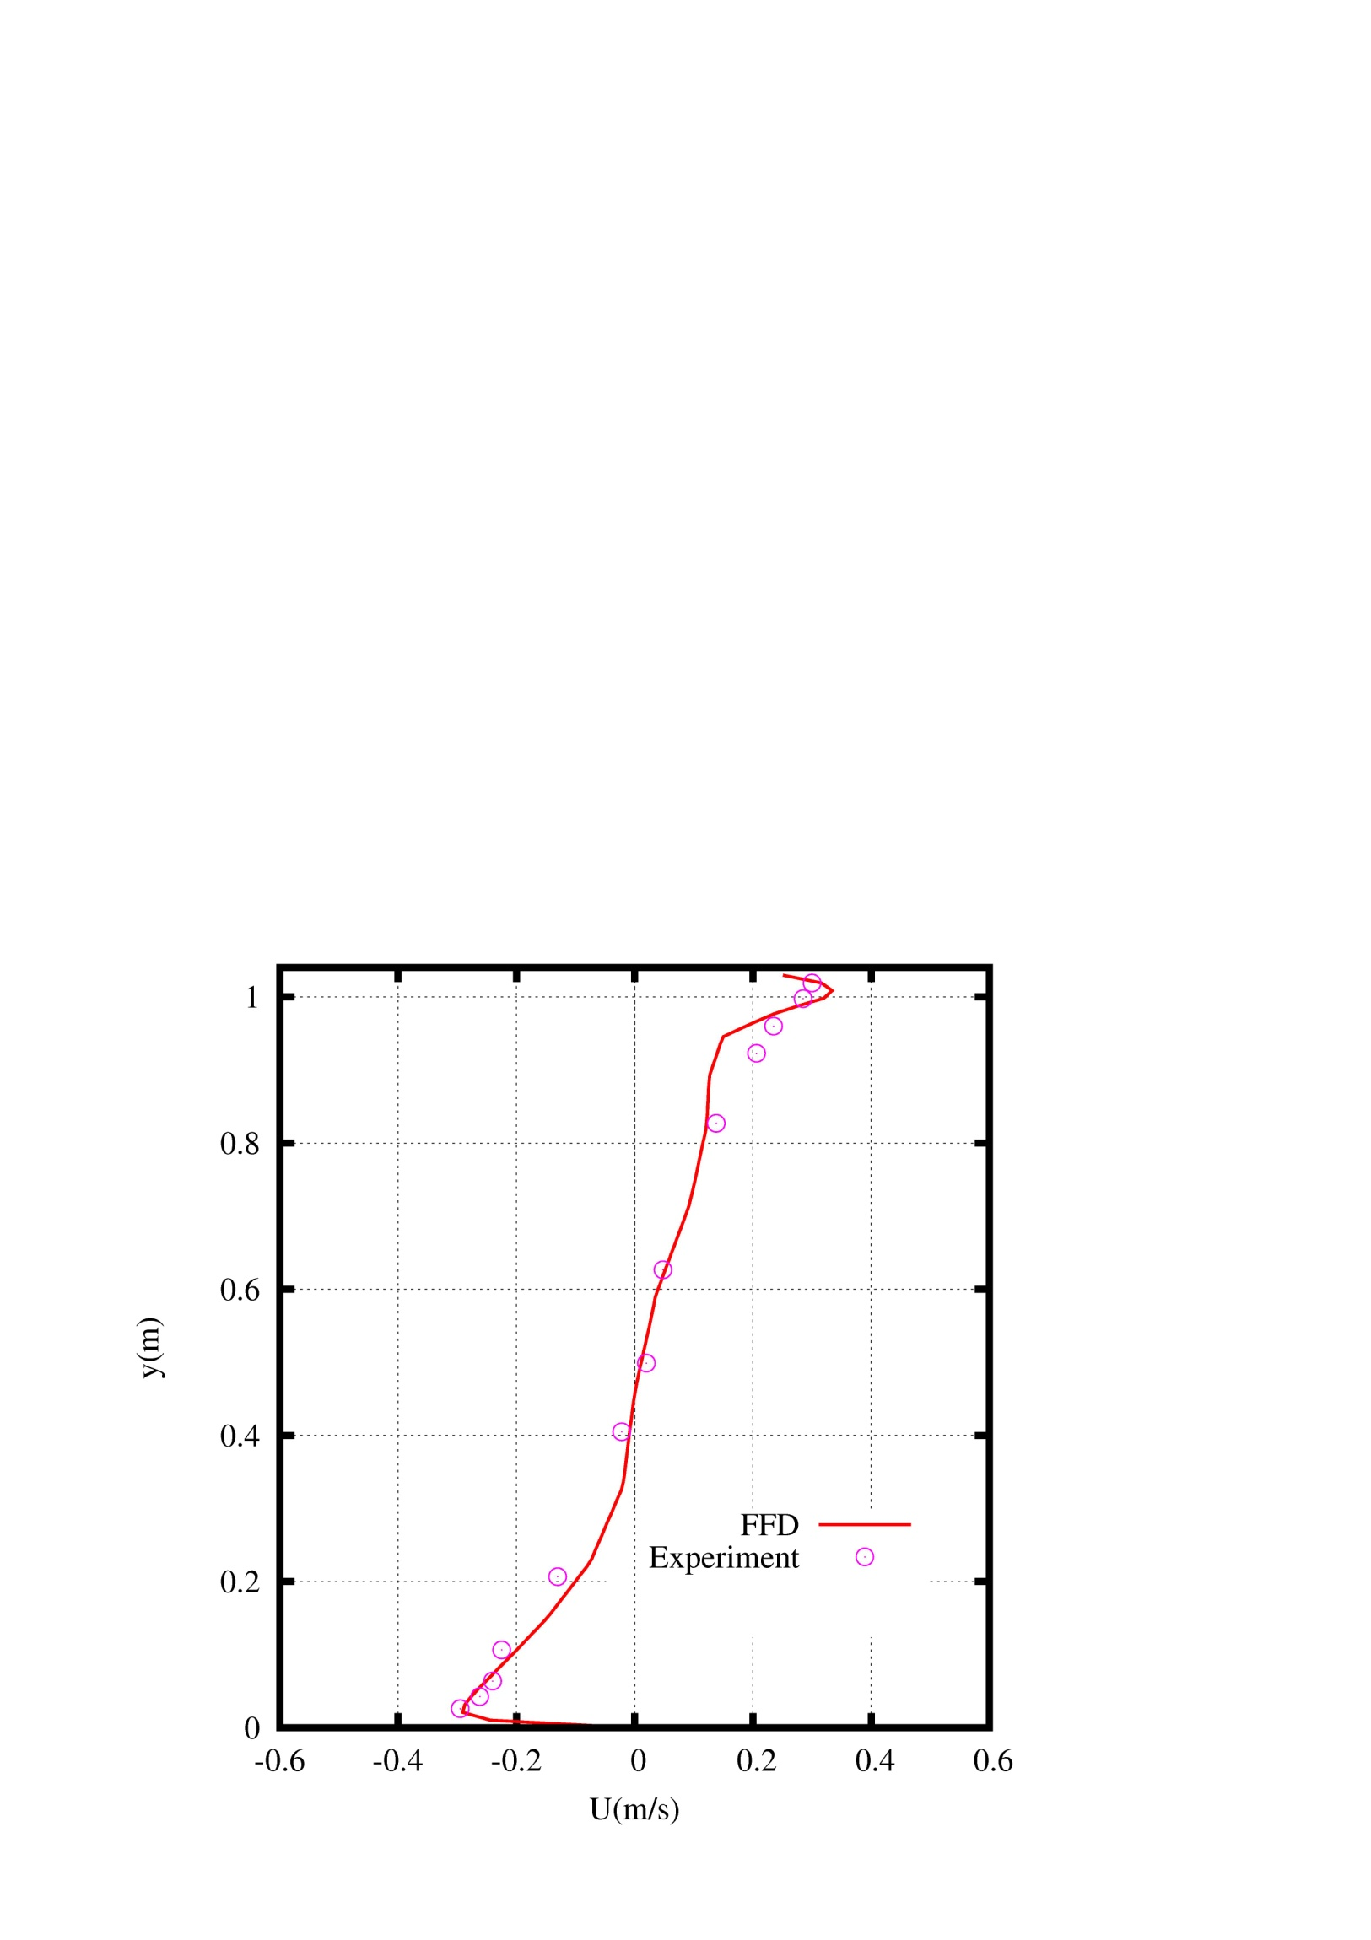
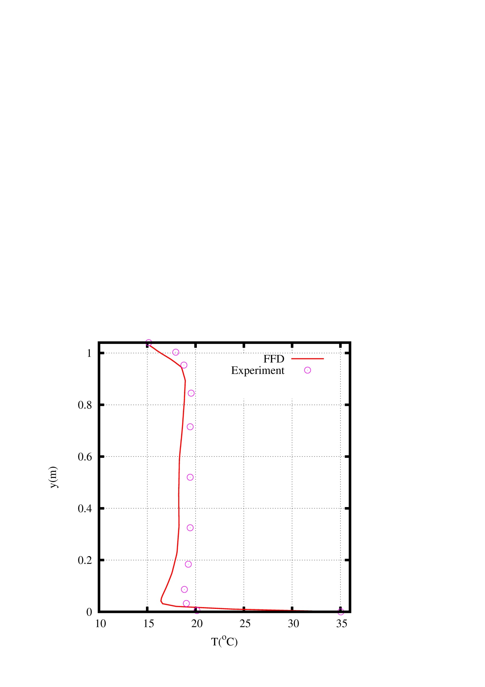
Mixed Convection: Results
Velocity
Temperature
Blay, D., Mergui, S., and Niculae, C. 1992. "Confined turbulent mixed convection in the presence of horizontal buoyant wall jet", Fundamentals of Mixed Convection, 213, 65-72
6

Slide 7
Implementation of FFD on GPU
Program Flow
CUDA Codes
cudaMalloc((void**)&d_vx, sizeof(float) * dimension);
…
cudaMemcpy(d_vy, vy, sizeof(float) * dimension, cudaMemcpyHostToDevice);
…
dim3 grid(imax/BLOCKDIM+ (!(imax%BLOCKDIM) ?0:1), jmax/BLOCKDIM+(!(jmax%BLOCKDIM)?0:1));
dim3 tids(BLOCKDIM, BLOCKDIM);
advect_k<<<grid, tids>>>(x, y, vx, vx0, vx0, vy0, imax, jmax, dt);
…
cudaMemcpy(vx, d_vx, sizeof(float) * geom.dimension, cudaMemcpyDeviceToHost);
…
cudaFree(d_vx);
…
7

Slide 8
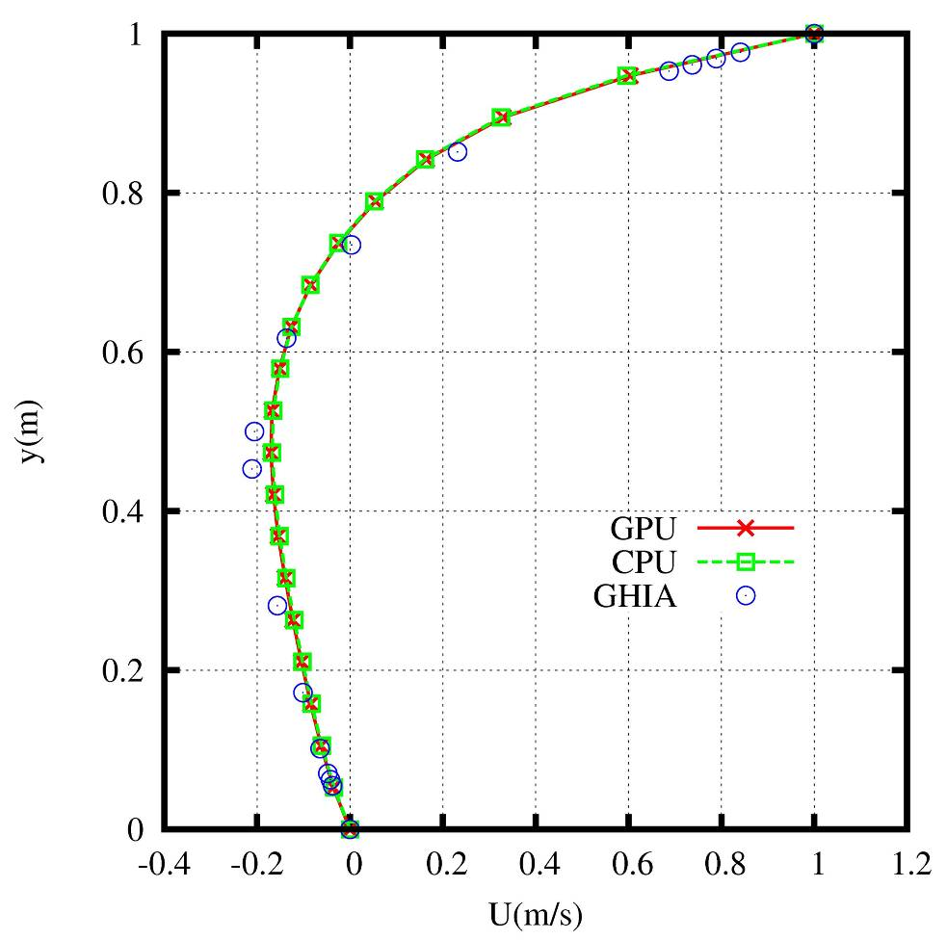
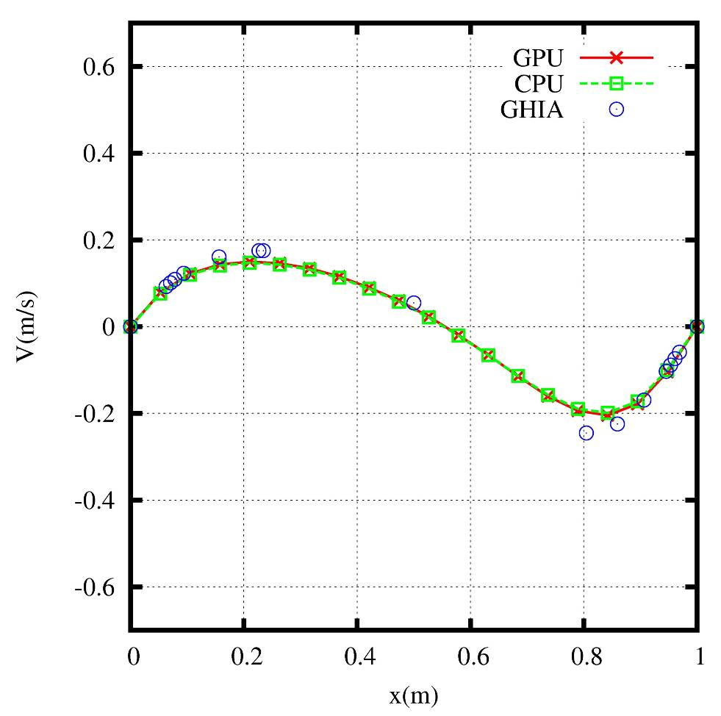
Example: Lid-Driven Cavity Flow
Reference Data from Ghia et al.1982
8

Slide 9
Simulation Speed
CFD on CPU
FFD on CPU
50 x
1500 x
FFD on GPU
30 x
25 hours CFD on CPU = 1 minute FFD on GPU
Lid-Driven Cavity Flow
Computing Time for 100 Time Steps
10 Seconds in Physical Process
CFD RNG k-ε Model; FFD Laminar Model
9

Slide 10
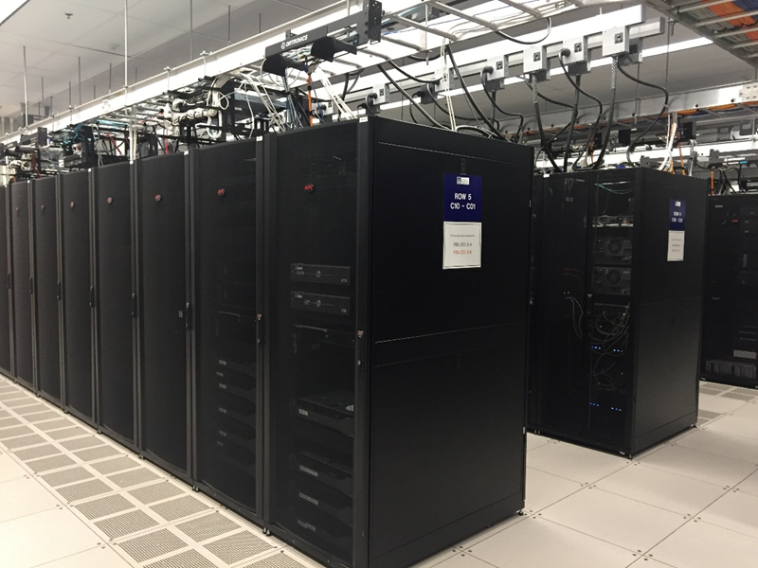
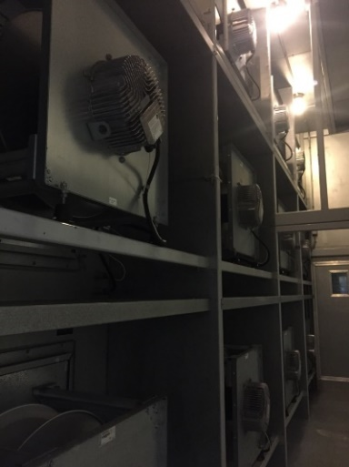
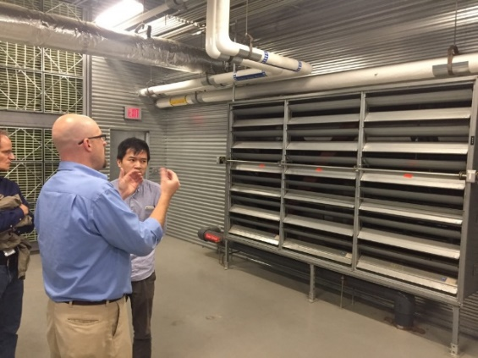
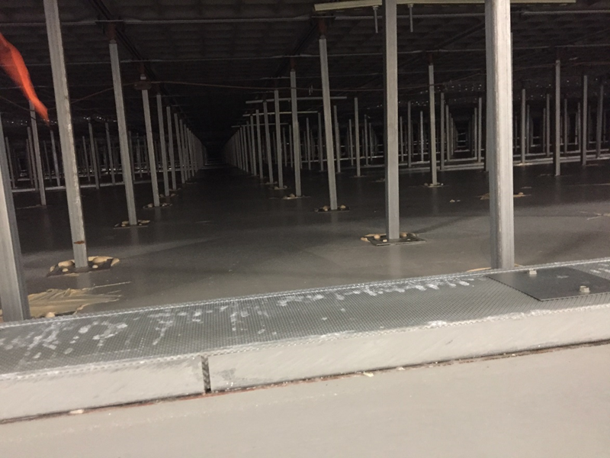
Example: Data Center Airflow Management
Location: Massachusetts
Climate Zone: 5A – cool and humid
Cooling System: chilled water system + ASE
Plan View of the Data Center
Side View of the Data Center
On-site Photos
10
10

Slide 11
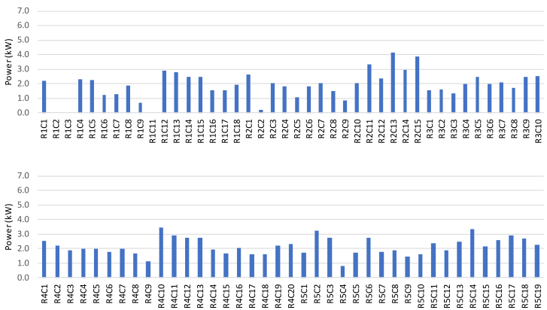
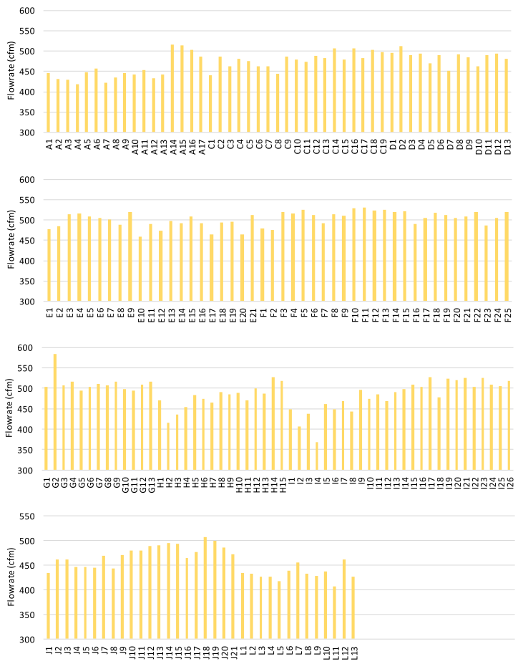
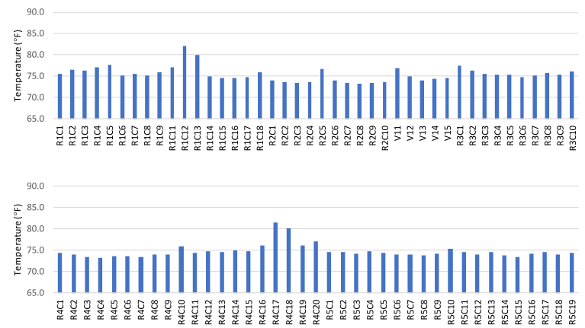
Airflow Measurement
Snapshot of the results:
Measured Rack Power Dissipation
Measured Perforated Tile Airflow Rates
Measured Equipment Inlet Temperatures
11
11

Slide 12
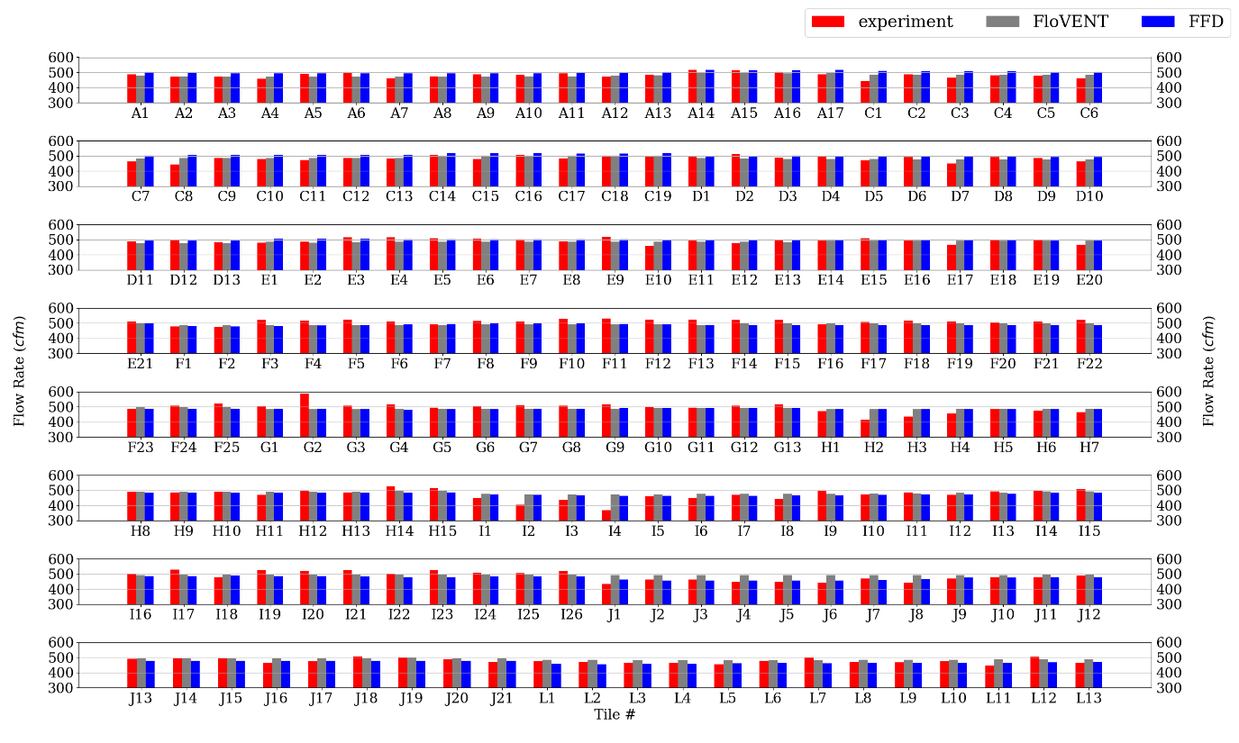
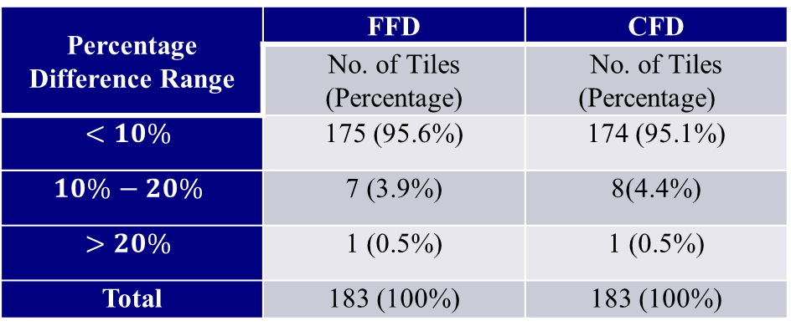
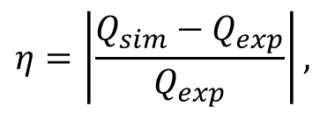
Model Validation: Plenum Airflow
Percentage Difference Range | FFD | CFD
 | No. of Tiles (Percentage) | No. of Tiles (Percentage)
$$<10\%$$ | 175 (95.6%) | 174 (95.1%)
$$10\%−20\%$$ | 7 (3.9%) | 8(4.4%)
$$>20\%$$ | 1 (0.5%) | 1 (0.5%)
Total | 183 (100%) | 183 (100%)
$$η=\left|\frac{Q_{sim}−Q_{exp}}{Q_{exp}}\right|,$$
Model DC Plenum Airflow
Compare flowrates at tiles from FFD and CFD with measured data
12

Slide 13
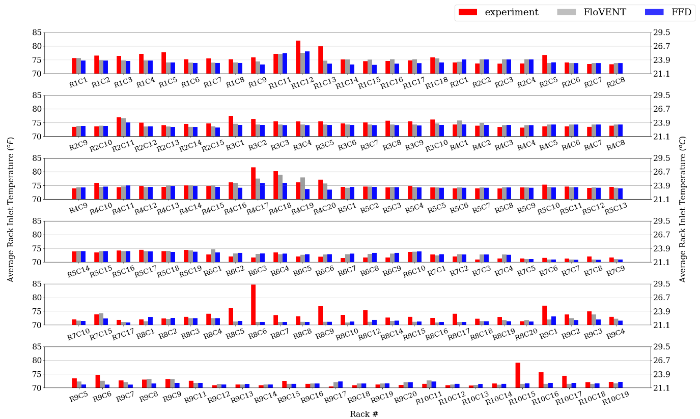
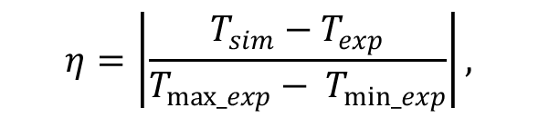

Model Validation: Room Airflow
Percentage Difference Range | FFD | CFD
 | No. of Racks (Percentage) | No. of Racks (Percentage)
$$<10\%$$ | 95 (68%) | 107 (77%)
$$10\%−20\%$$ | 37 (27%) | 28 (20%)
$$>20\%$$ | 17 (5%) | 14 (3%)
Total | 139 (100%) | 139 (100%)
$$η=\left|\frac{T_{sim}−T_{exp}}{T_{max_exp}− T_{min_exp}}\right|,$$
Model DC Room Airflow
Compare rack-inlet temperatures from FFD and CFD with measured data
13

Slide 14
Bibliography
Zuo, W., Chen, Q. 2009. Real-time or faster-than-real-time simulation of airflow in buildings. Indoor Air 19(1): 33-44.
Zuo, W., Chen, Q. 2010. Simulations of air distribution in buildings by FFD on GPU. HVAC&R Research 16(6): 783-796.
W. Zuo, M. Wetter, W. Tian, D. Li, M. Jin, Q. Chen 2016. "Coupling Indoor Airflow, HVAC, Control and Building Envelope Heat Transfer in the Modelica Buildings Library.” Journal of Building Performance Simulation, 9(4), pp. 366-381.
W. Tian, J.W. VanGilder, X. Han, C.M. Healey, M.B. Condor, W. Zuo 2019. “A New Fast Fluid Dynamics Model for Data-Center Floor Plenums”. ASHRAE 2019 Winter Conference, January 12-16, Atlanta, GA.
W. Tian, T. A. Sevilla, D. Li, W. Zuo, M. Wetter 2018. "Fast and Self-Learning Indoor Airflow Simulation Based on In Situ Adaptive Tabulation." Journal of Building Performance Simulation, 11(1), pp. 99-112.
Performance Simulation, 11(1), pp. 99-112.

